Slide 1
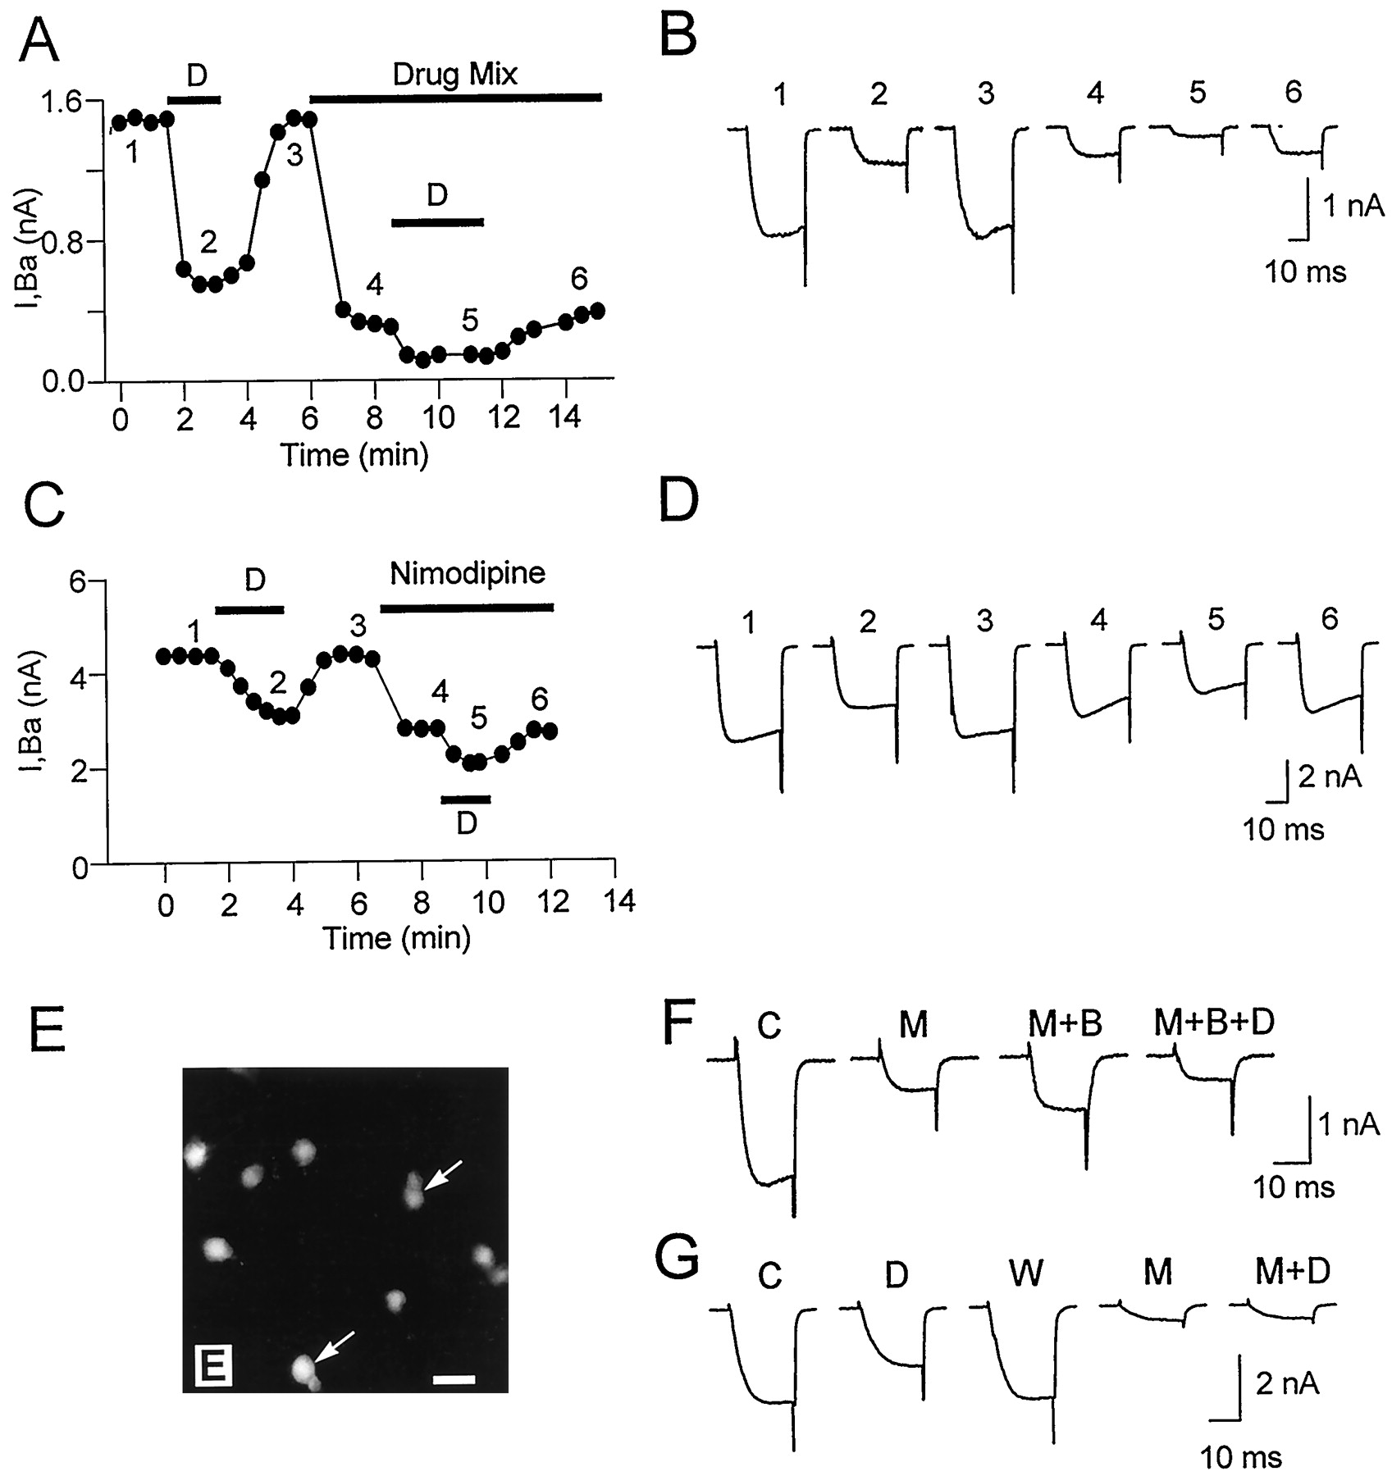

DOR-mediated inhibition of the dihydropyridine-sensitive L-type current.
Cristian G. Acosta, and Héctor S. López J. Neurosci. 1999;19:8337-8348
©1999 by Society for Neuroscience
Notes:
DOR-mediated inhibition of the dihydropyridine-sensitive L-type current. Data points inA and C represent values ofI_{Ba} at the end of 25 msec test pulses to 0 mV from a V_{H} of −70 mV. A,Time course of an experiment testing the L-type current contribution toI_{D} with protocol-1. The first DADLE application reversibly inhibited 63% ofI_{Ba}. Subsequently, the block of N-, P-, and Q-type currents with 2 μm ω-CTx-GVIA, 50 nmω-Aga-IVA, and 1 μm ω-CTx-MVIIC (Drug Mix) inhibited 81% of I_{Ba}. The contribution of the L-type current to I_{D} was revealed by a second DADLE application, which inhibited 53% of the non-N, non-P, and non-Q currents in a fully reversible way.B, Current records corresponding to similarly numbered data points in A. C, Time course of an experiment testing the L-type contribution toI_{D} with protocol-2. The block of the L-type current fraction (36% in this cell) with 10 μmnimodipine reduced the amount of I_{Ba}inhibited by 1 μm DADLE. The second DADLE application was done in the continuous presence of nimodipine. D,Current records corresponding to similarly numbered data points inC. The current reversibly inhibited by DADLE decreased from 1.3 to 0.74 nA after blocking the L-type current with 10 μm nimodipine. E, All sensory neurons in culture, regardless of cell subpopulation, were immunoreactive for the α_{1C} subunit of neuronal Ca²⁺ channels, indicating the presence of L-type HVACC in these cells. Neurons obtained from 5-d-old postnatal animals. P-neurons in the culture are labeled with arrows. Scale bar, 20 μm.F, The control HVACC current (trace C), activated by voltage pulses to 0 mV from aV_{H} of −70 mV, was partially blocked by a mixture of 2 μm ω-CTx-GVIA, 50 nmω-Aga-IVA, and 1 μm ω-CTx-MVIIC, which was kept in the bath for the rest of the experiment (trace M). S-(±)-Bay-K 8644 (10 μm) increased the amplitude of the drug mixture-resistant current (trace M+B), and the subsequent application of 1 μm DADLE in the continuous presence of Bay-K 8644 reduced the enhanced current (M+B+D). The magnitude of the inward current in the presence of DADLE was smaller than that beforeS-(±)-Bay-K 8644 application. G, The R-type current, defined as the current remaining unblocked in the presence of a mixture of 10 μm nimodipine, 2 μm ω-CTx-GVIA, 50 nm ω-Aga-IVA, and 1 μm ω-CTx-MVIIC (trace M), was completely insensitive to DADLE (trace M+D). The agonist reversibly inhibited I_{Ba} before the application of the drug mixture (traces C, D, W). Data from a P-neuron.

