Slide 1
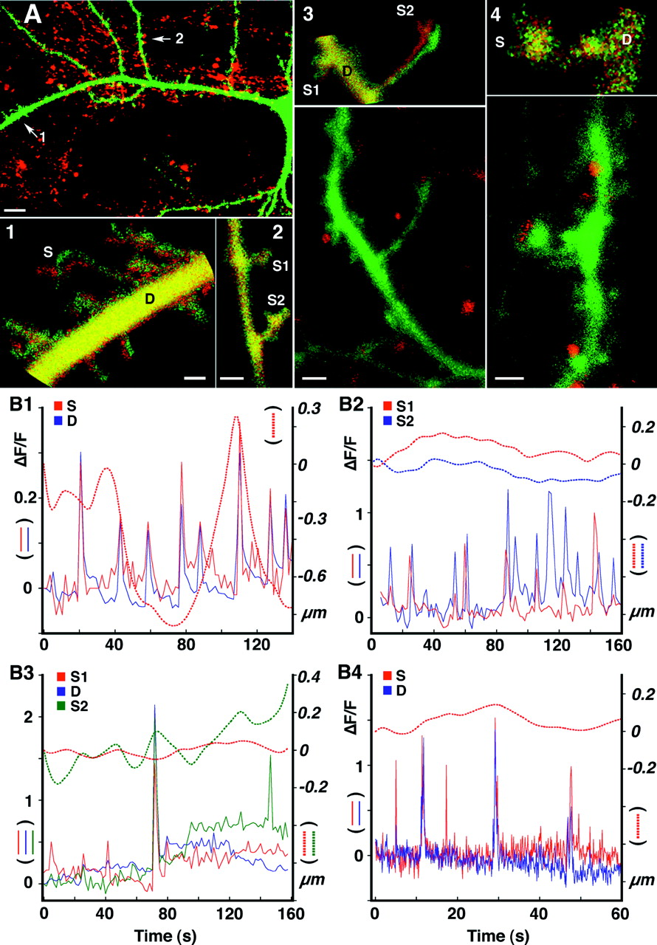

Lack of correlation between spine motility, calcium variations, and afferent innervation.
Eduard Korkotian, and Menahem Segal J. Neurosci. 2001;21:6115-6124
©2001 by Society for Neuroscience
Notes:
Lack of correlation between spine motility, calcium variations, and afferent innervation. Cells were loaded individually with a calcium dye, OG-1. At the end of the observation time, cultures were exposed to the membrane dye FM4-64 to identify presynaptic terminals. A, Low-power view of a cell taken from a 2-week-old culture, showing in greenthe dendritic field of the cell, soma on the right edge, and inred, FM4-64 puncta. Scale bar, 10 μm. A1, A2, High-power images of dendritic segments taken fromA, indicated by arrows (1, 2). Each image is a composite picture taken at two time points, at which the dendritic spines are at their farthest spatial positions within the 100 sec of observation. Red indicates one position, green indicates the other position, andyellow denotes overlap in the two positions. The main difference between A1 and A2 is in the presence of FM4-64 dots in A2 and absence of dots in A1. A3, A4, Three-week-old culture, showing different images ontop and the same images counterstained with FM4-64 at the bottom. A large FM particle is seen adjacent to the short spine on the left, and a small dot is seen adjacent to the long spine on the right. The difference image on top shows little movement of the left spine and a large movement of the right spine.A4, High-power image of a medium-sized spine, adjacent to an FM dot to show little disparity in position of the spine in space over time. Scale bars: A1–A4, 1 μm.B1–B4, Correlating movement and calcium transients over time. Spines correspond to those shown in A1–A4, with the notations S for spine, D for dendrite, S1 for spine 1, and S2for spine 2. Overlapped are the calcium transients, incontinuous lines, quantified as ΔF/F, and the movement is indicated with dotted lines. A clear lack of correlation between the calcium transients and local motility is seen. In general, calcium transients in the spine head and the parent dendrites are correlated, with notable exceptions. Larger variations in calcium transients are seen in B2 compared with B1, as well as a large disparity between adjacent spines. In B3, a comparison between the mobile and the immobile spines indicates that although both can express simultaneous calcium transients, the long spine is more independent from the parent dendrite than the short one. B4, At a high temporal resolution, large dendritic calcium events are always seen also in the spine, whereas the opposite is not always true, and independent calcium transients can be seen in the spine. Altogether, the spine expresses little motility compared with the other ones.

