Slide 1
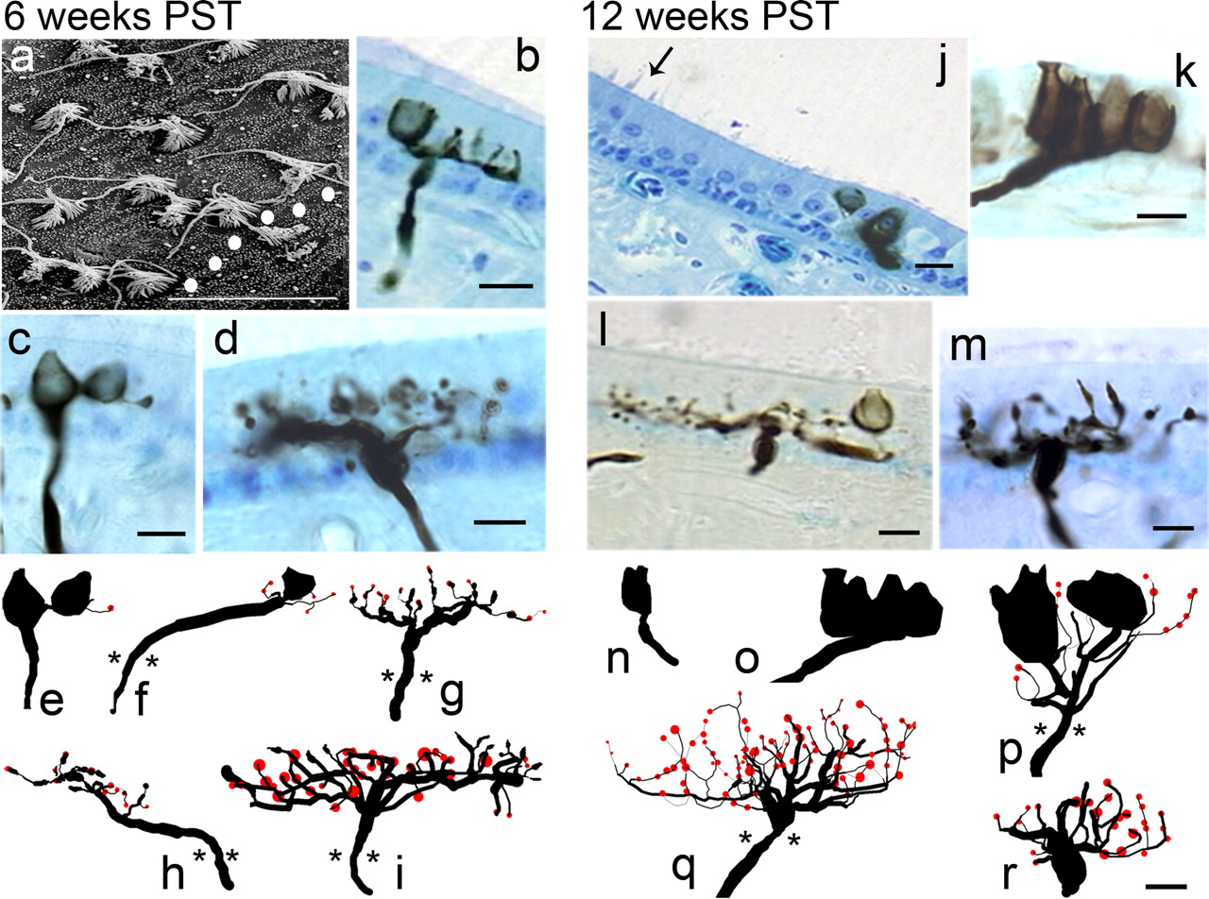

Photomicrographs and anatomical reconstructions of stage 2 regenerating afferents: 6 weeks PST (a–i) and 12 weeks PST (j–r). a, Scanning electron microscopy of striola region near the polarization reversal line (dotted).
Mridha Zakir, and J. David Dickman J. Neurosci. 2006;26:2881-2893
©2006 by Society for Neuroscience
Notes:
Photomicrographs and anatomical reconstructions of stage 2 regenerating afferents: 6 weeks PST (a–i) and 12 weeks PST (j–r). a, Scanning electron microscopy of striola region near the polarization reversal line (dotted). Both mature and developing stereocilia bundles were present, with a clear demarcation of polarity for each hair cell. b, Developing dimorph afferent with two prototypic calyceal terminals in the striolar region. c, Developing dimorph afferent with a calyceal terminal that has a complete encompassing structure around one hair cell and a partial formation around a second. d, Bouton afferent in the medial extrastriola with multiple branch segments, terminal boutons, and several growth cones. e, f, Type I hair cells and calyceal terminals were first observed only on dimorph afferents at 6 weeks PST. Bouton afferents exhibited increased structural complexity, many with both terminal boutons (red) and growth cones (g–i). Few afferents had long initial segments (f, h); more exhibited branching arborizations near the point of epithelial penetration (g, i). j, Medial striolar region at 12 weeks PST, with reversal line (arrow), broad type II band, and developing calyceal terminal of calyx afferent. k, Calyx afferent contains five type I hair cells, with complete formation around some receptor cells, but developing formation around others. l, Dimorph afferent with complete calyceal terminal, numerous branch segments, and terminal boutons. m, Bouton afferent with multiple branch segments immediately beyond penetration point, with terminal boutons and growth cones. n, o, Calyceal terminals were present for the first time in calyx afferents at 12 weeks PST, but these fibers were few in number and most were immature. The majority of calyceal terminals were contained in dimorph afferents, which appeared more structurally complex (p). Bouton afferents increased in complexity with dense arborizations and numerous terminals (q, r). A mixture of growth cones and bouton terminals was observed. Asterisks denote penetration point in receptor epithelium. Scale bar, 10 μm.

