Slide 1
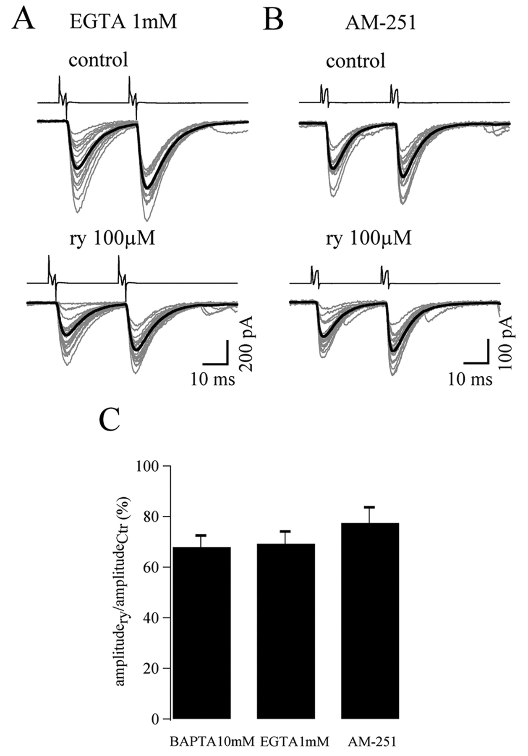

Retrograde messenger release by Purkinje neurons does not significantly contribute to the ryanodine effect.
Micaela Galante, and Alain Marty J. Neurosci. 2003;23:11229-11234
©2003 by Society for Neuroscience
Notes:
Retrograde messenger release by Purkinje neurons does not significantly contribute to the ryanodine effect. A, eIPSC amplitudes elicited in a Purkinje neuron loaded with 1 mm EGTA in control (top) and in ryanodine (bottom; ry). Averaged currents are superimposed (black trace). B, Block of RyRs still reduces eIPSCs when CB₁ receptors are blocked with 0.5 μm AM-251. C, Reduction of eIPSCs by ryanodine is similar when buffering the Purkinje cell with 10 mm BAPTA (first column; n = 13) or with 1 mm EGTA (second column; n = 7) and in the presence of AM-251 (third column; n = 8). Values are normalized with respect to the control (Ctr) eIPSC amplitude. There are no significant differences between the three mean values.

