Slide 1
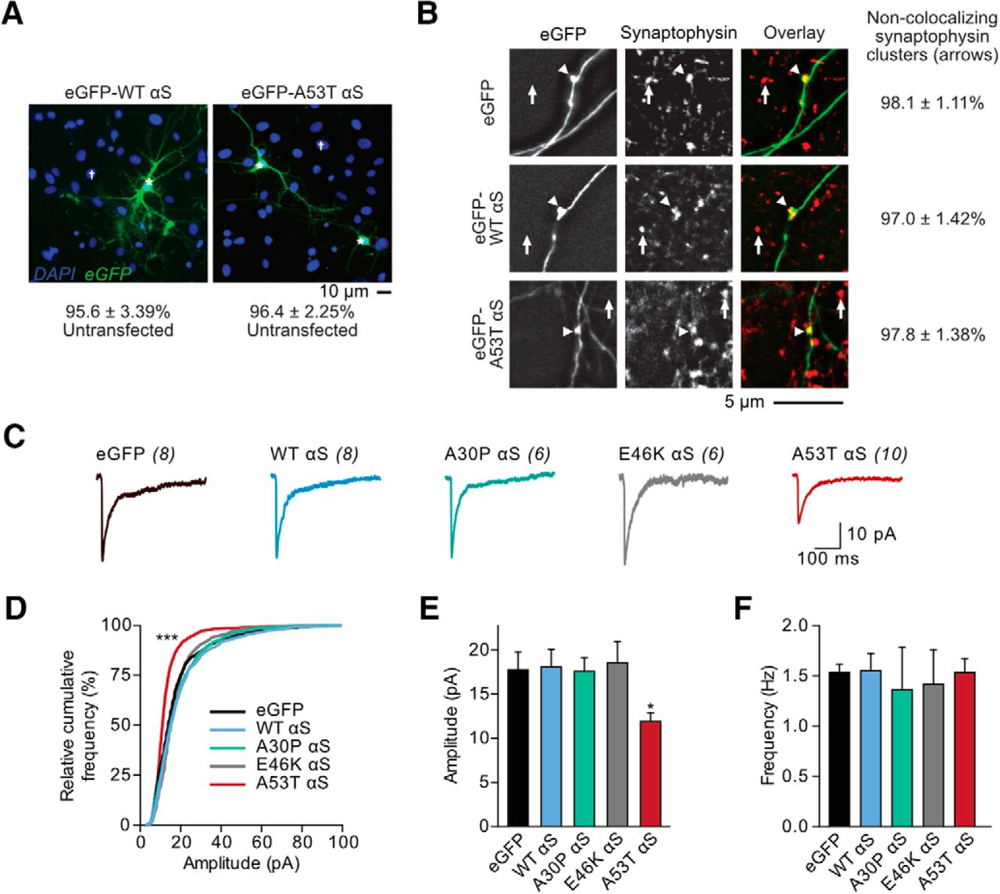

A53T αS-induced postsynaptic deficits are cell autonomous.
Peter J. Teravskis et al. J. Neurosci. 2018;38:9754-9767
©2018 by Society for Neuroscience
Notes:
A53T αS-induced postsynaptic deficits are cell autonomous. A, Wide-field fluorescence photomicrographs from cultured rat hippocampal DAPI-stained neurons expressing eGFP-tagged WT and A53T αS plasmids via calcium-phosphate transfection. The percentage of untransfected cells was tabulated. B, Photomicrographs of fixed neurons that had been transfected with eGFP, eGFP-WT αS, or eGFP-A53T αS plasmids (left) and subsequently stained with a mouse anti-synaptophysin antibody (middle; with overlay on the right). Axons were visually traced and defined as thin, long neurites emerging from the soma with occasional perpendicular branch points. Arrows represent nonoverlapping synaptophysin clusters; arrowheads point to synaptophysin-filled, eGFP-expressing synaptic boutons. The percentage of synaptophysin clusters free of exogenous αS expression was calculated. C, Whole-cell AMPAR mEPSCs were recorded from cultured rat hippocampal neurons transfected with eGFP alone or eGFP-fused αS species. Scale bar, 10 pA, 100 ms. D, Relative cumulative frequency of mEPSC amplitudes. Kolmogorov–Smirnov test, D = 0.39; ***p < 0.0001. E, F, Mean mEPSC amplitudes and frequencies. One-way ANOVA with Bonferroni post hoc analysis, F_{(4,32)} = 3.65; *p = 0.012. All data are expressed as mean ± SEM.

